Slide 1

Exploratory Data Analysis — Superstore Sales (2011–2014)
Data-driven review of four years of transactional sales to uncover trends, regional dynamics, category performance, and profitability drivers. Audience: business analysts and retail managers. This deck summarizes findings, evidence, and concrete recommendations to guide pricing, inventory, and regional strategy.

Slide 2

Why this analysis matters
Retailers operate in a data-rich but fast-moving market. This EDA translates transactional records into actionable insights on seasonality, high-value products, regional demand, and margin sensitivity. The goal: support decisions that improve forecasting, protect margins, and prioritize investments in high-growth segments. Key business questions: total sales trends, top-performing categories, regional differences, and profitability drivers.

Slide 3

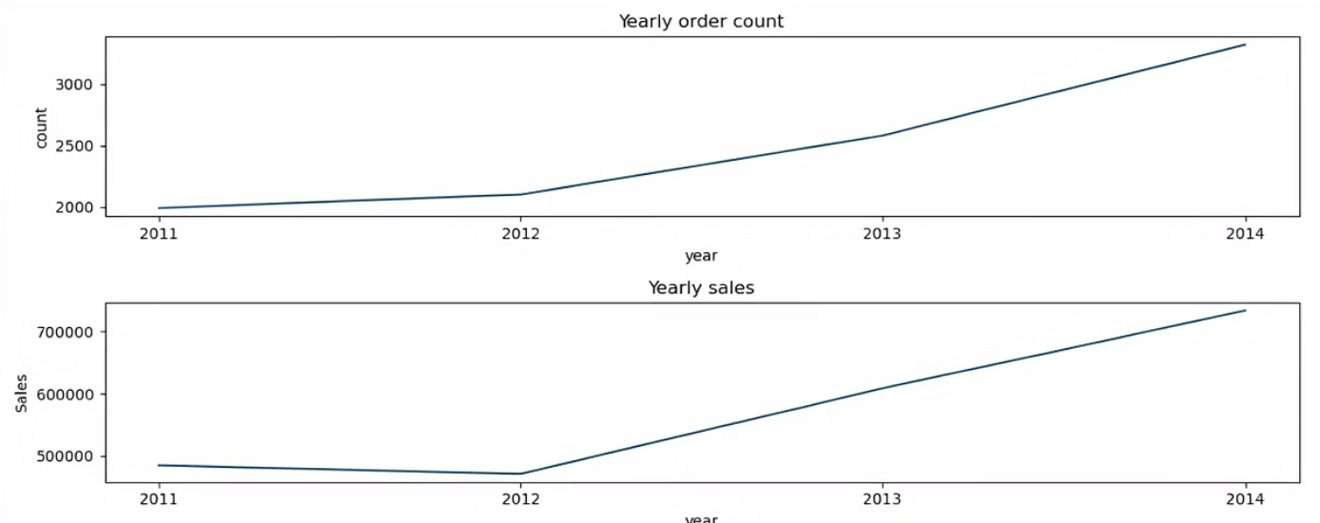
Overall temporal trends & seasonality
Sales increased overall from 2011–2014 with uneven growth: 2013 strongest, 2012 weakest. Clear seasonality: strong year-end peaks (Nov–Dec) and a recurring September uplift (academic/office buying). Monthly volatility spikes in March, September, and October indicate promotional or demand shocks that require forecasting adjustments.
Implications: align inventory and promotions to September and holiday peaks, use volatility windows to stress-test fulfillment and promotions.

Slide 4
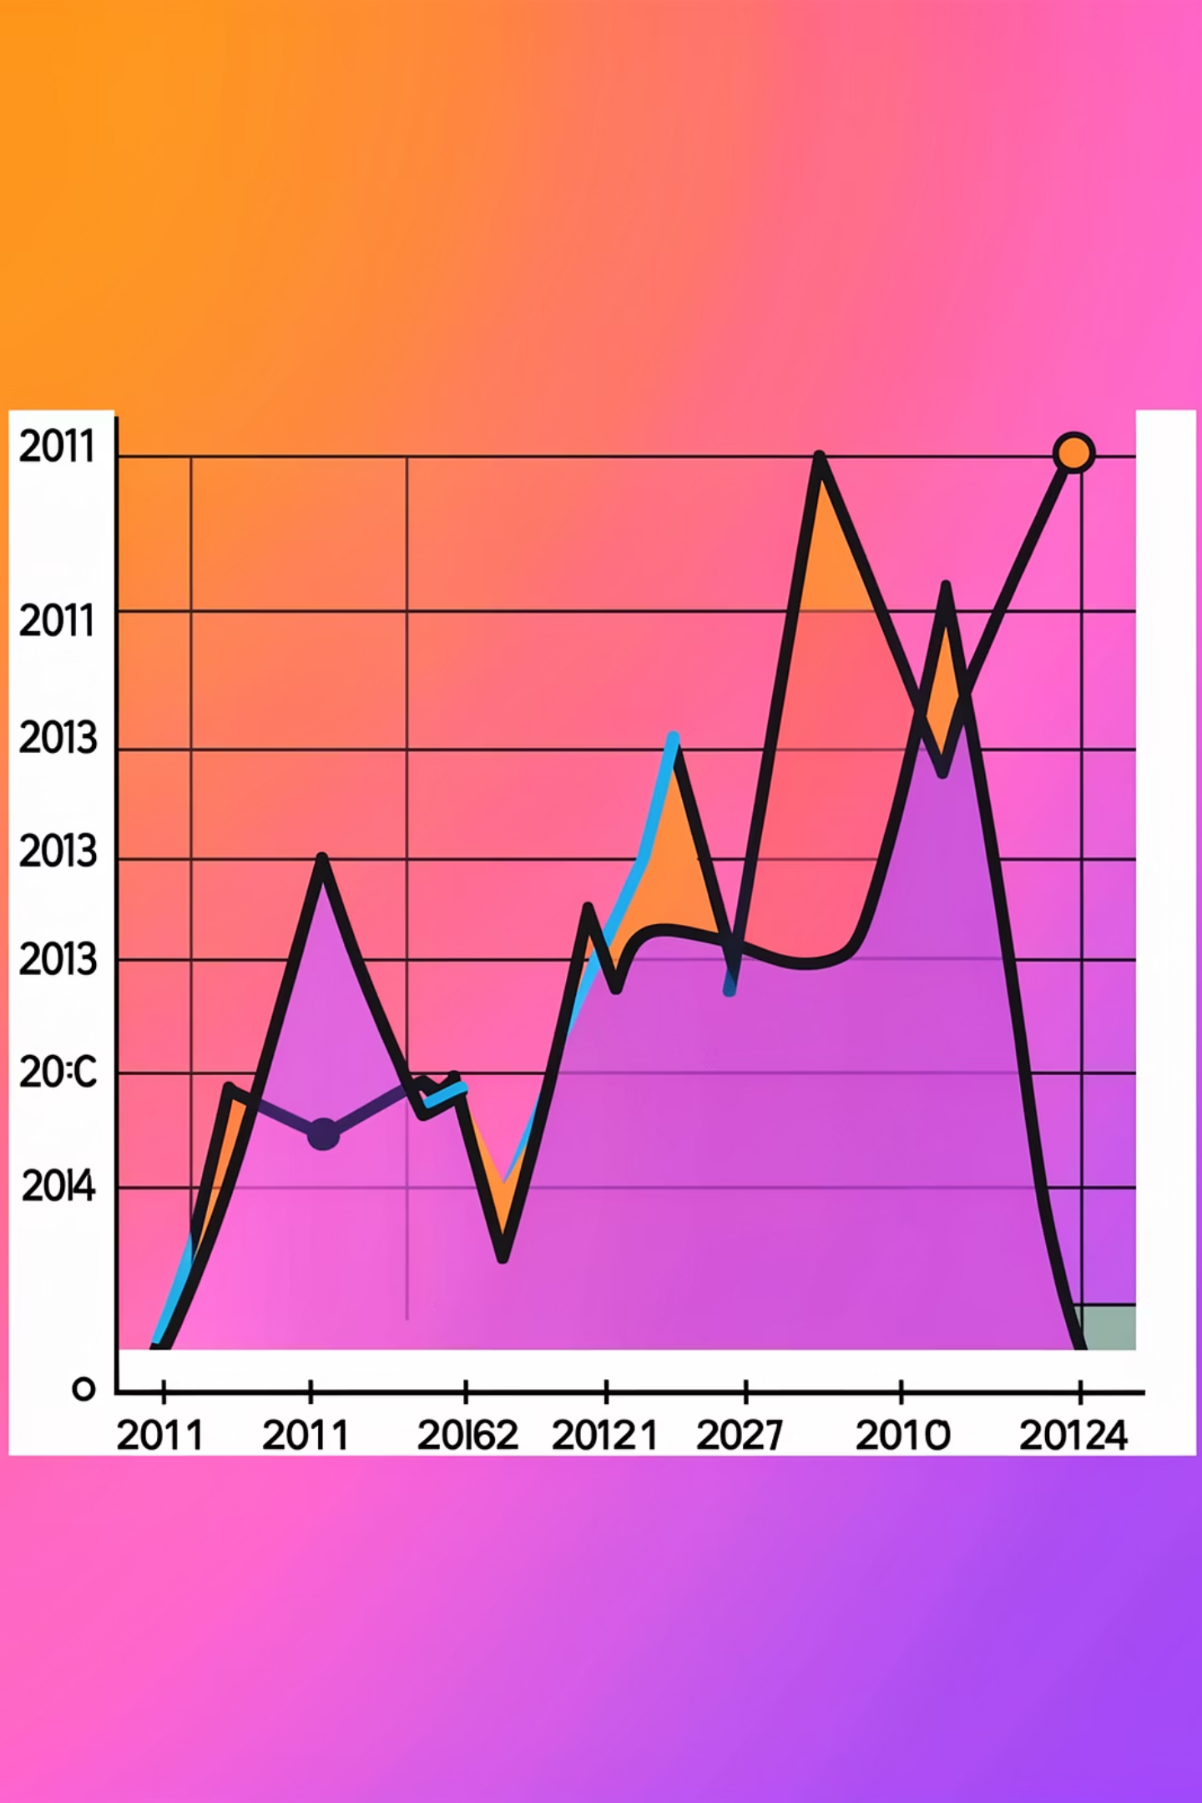
Monthly patterns — volatility and central tendency
Trend
Volatility
Upward trajectory across four years but punctuated by intermittent dips (notably 2012).
High standard deviation during early 2011 and late 2013 — periods that require flexible supply planning and promotional controls.
Recommendation
Incorporate volatility bands into forecasts and maintain safety stock for Nov–Dec and September surges.

Slide 5
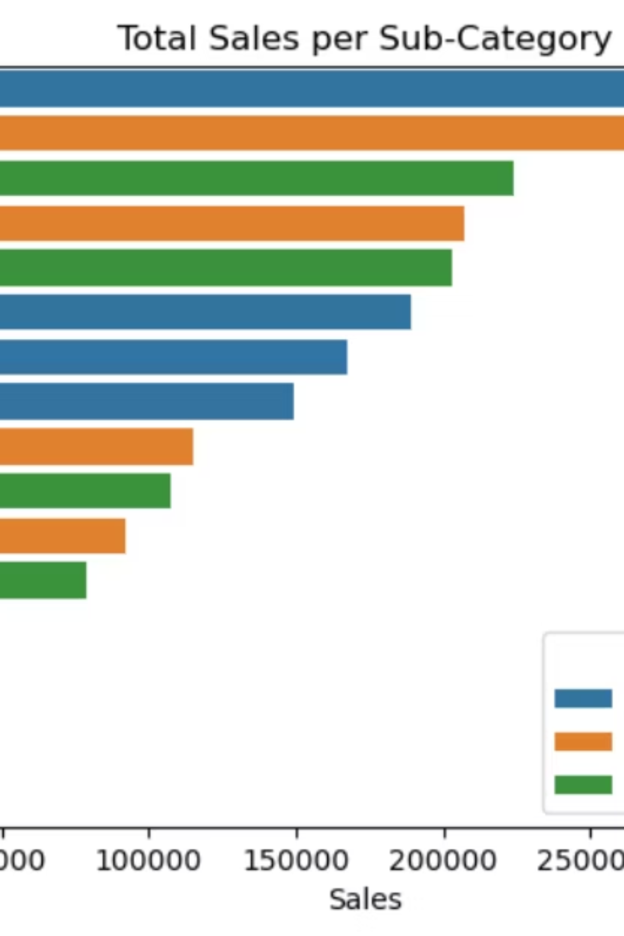
Category & sub-category revenue leaders
Top revenue drivers: Phones (Technology), Chairs (Furniture), Storage (Office Supplies). High-ticket items dominate total revenue; lower-priced volumes contribute less to dollar sales despite higher transaction counts in some segments. Low performers by revenue include copiers, furnishings, and fasteners.
Business implication: prioritize merchandising, supplier negotiation, and inventory for high-ticket sub-categories while evaluating promotional mechanics for low-margin items.

Slide 6
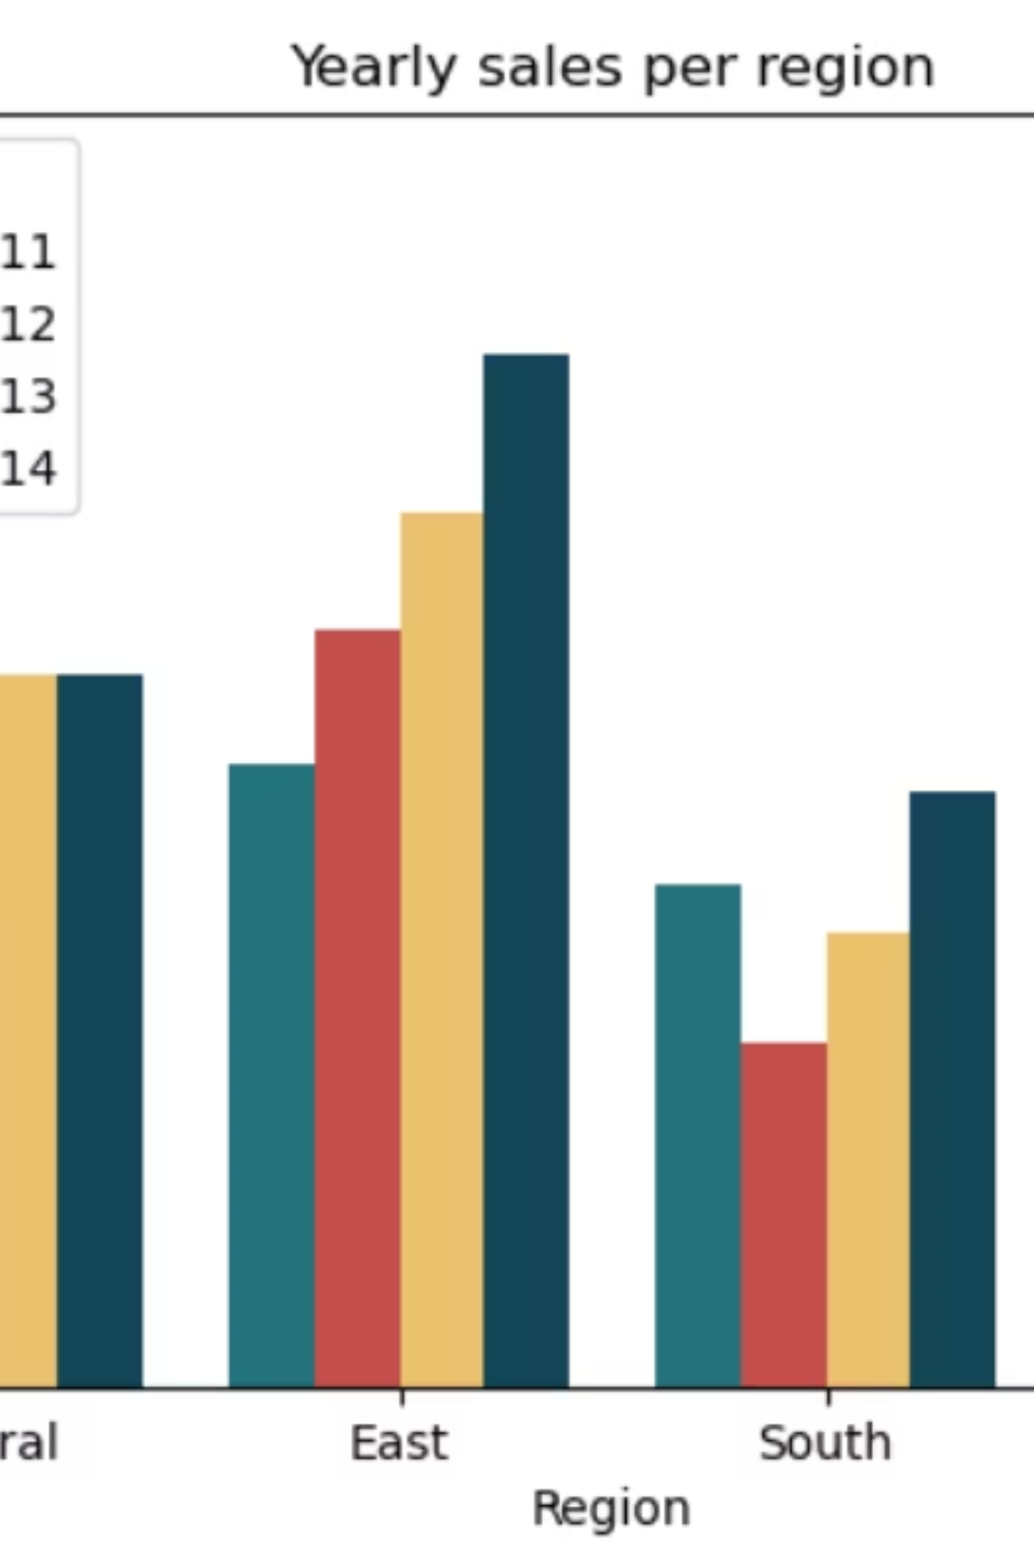
Year-over-year and regional distribution
Regional snapshot: West leads in total sales and fastest AAGR, East shows steady growth and stability, Central and South lag. 2012 dip concentrated in South and West; recovery across all regions begins 2013. Regional patterns suggest market maturity differences and demand heterogeneity that justify differentiated regional strategies.

Slide 7
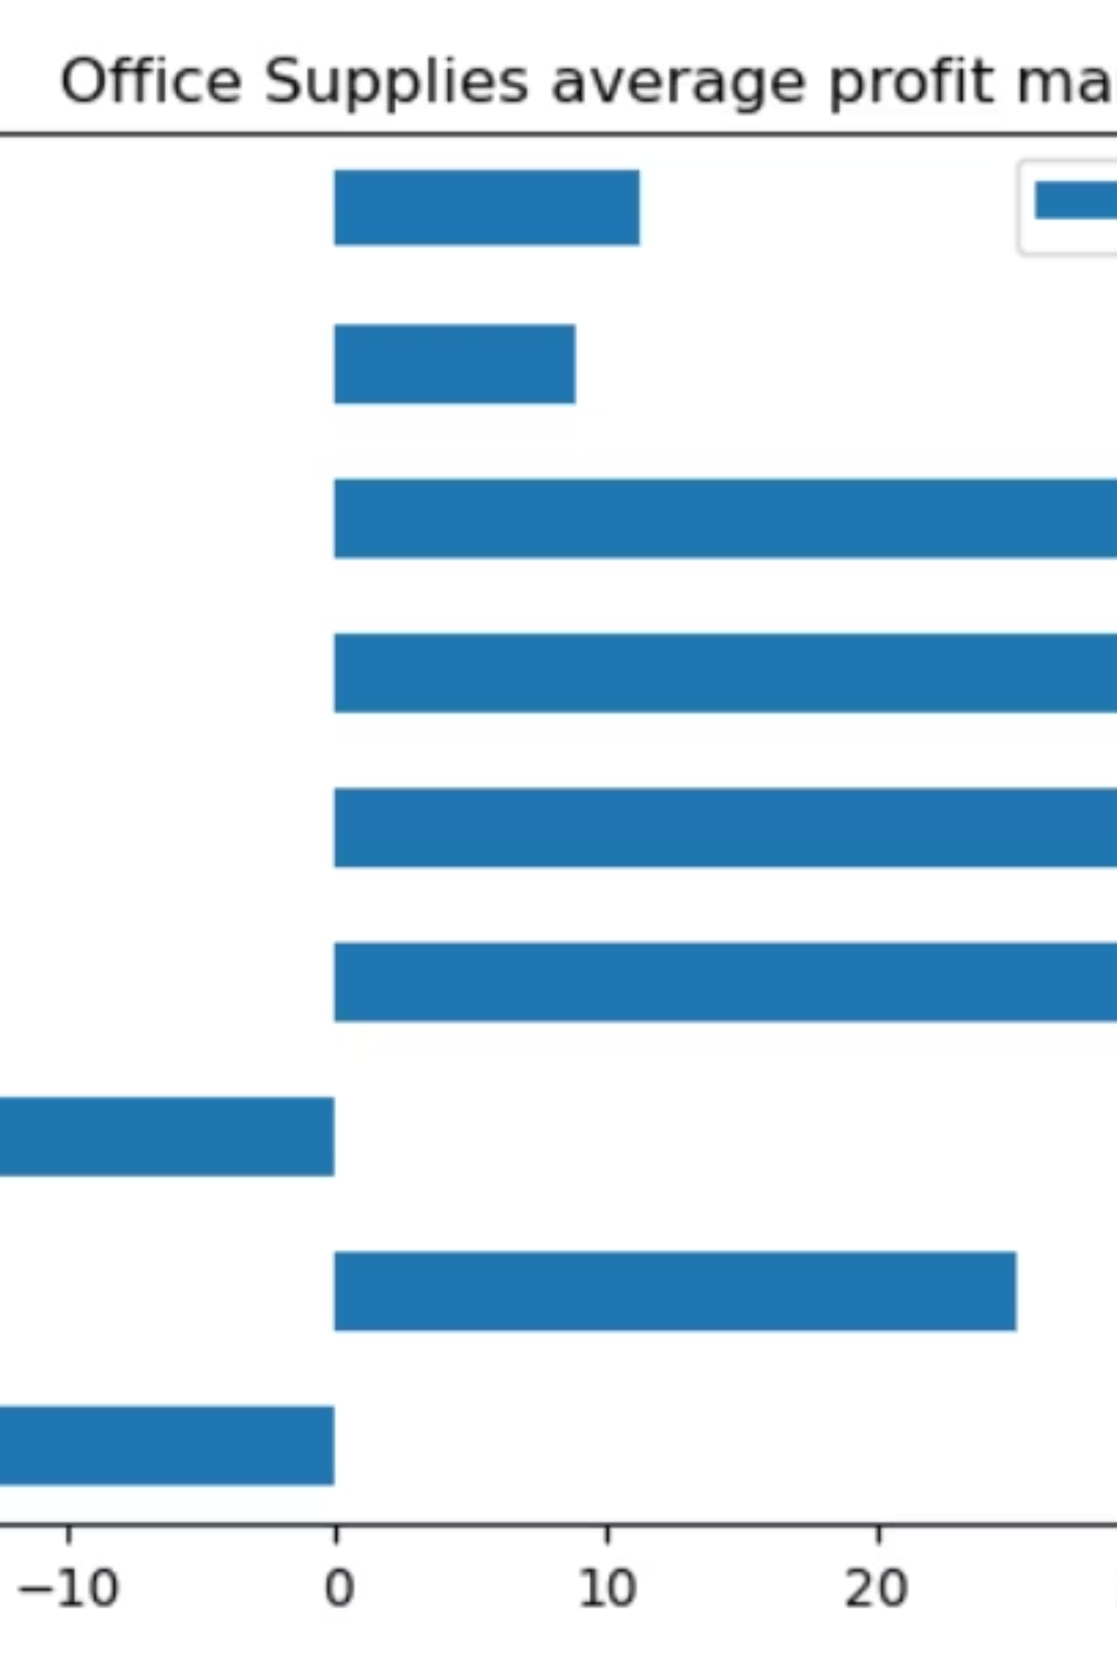
Profitability overview — margins & discount impact
Aggregate profit margins stayed above 10% (2011:10.23%, 2012:13.10%, 2013:13.43%, 2014:12.74%). Top profit contributors: Phones, Chairs, Binders. Minimal contributors: Machines, Bookcases, Fasteners. Discounting materially eroded margins—tables moved toward negative profitability post-discount in multiple periods.
Action: enforce margin-aware discount thresholds and track promo lift versus margin erosion at the SKU/sub-category level.

Slide 8



Sub-category growth dynamics
Supplies
Copiers & Appliances
Chairs & Furnishings
Highest average annual growth — consider increased inventory, targeted promotions, and improved shelf availability to capture momentum.
Strong growth but lower volume; invest selectively in marketing and service bundles to maximize margin capture.
High revenue but slow growth — reassess product lifecycle and promotional elasticity to avoid margin leakage from price-driven promotions.

Slide 9
Data-driven strategic recommendations
01
02
03
1. Optimize discounting
2. Invest in high-growth categories
3. Region-specific tactics
Move from volume-based blanket discounts to margin-aware rules by sub-category; protect high-margin SKUs and avoid negative-margin promotions.
Allocate marketing and inventory to Supplies, Copiers, and Appliances to capture accelerating demand and economies of scale.
Scale successful West/East programs; design tailored assortments and promotions for the South to stimulate demand where penetration is lower.
04
05
4. Strengthen seasonal planning
5. Enhance profitability monitoring
Embed September and year-end peaks into supply planning and campaign calendars; use volatility buffers for high-variance months.
Implement transaction-level margin tracking and alerting to detect loss-making orders and prevent systemic cross-subsidization.

Slide 10

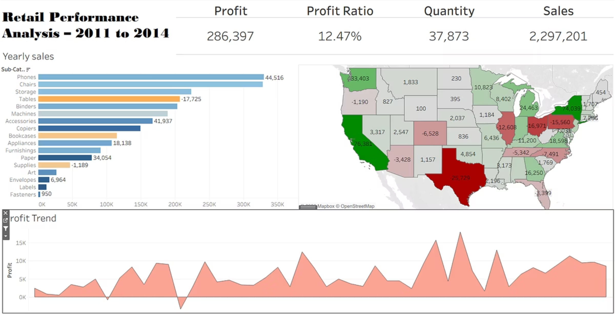

Conclusion & next steps
The Superstore EDA shows sustained revenue growth, clear seasonality, and concentrated revenue in high-ticket sub-categories. Primary risks: margin erosion from undisciplined discounts and uneven regional performance. Next steps: operationalize margin-aware promotions, pilot targeted investments in high-growth sub-categories, and implement region-specific merchandising tests. Establish measurement cadence (monthly sales, AAGR, margin by SKU) to monitor impact.
Proposed immediate actions: 1) Run a 90-day discount audit for tables/bookcases, 2) Increase safety stock for Sep & Nov–Dec peaks, 3) Launch a West-region expansion pilot for top phone SKUs.

